Slide 1
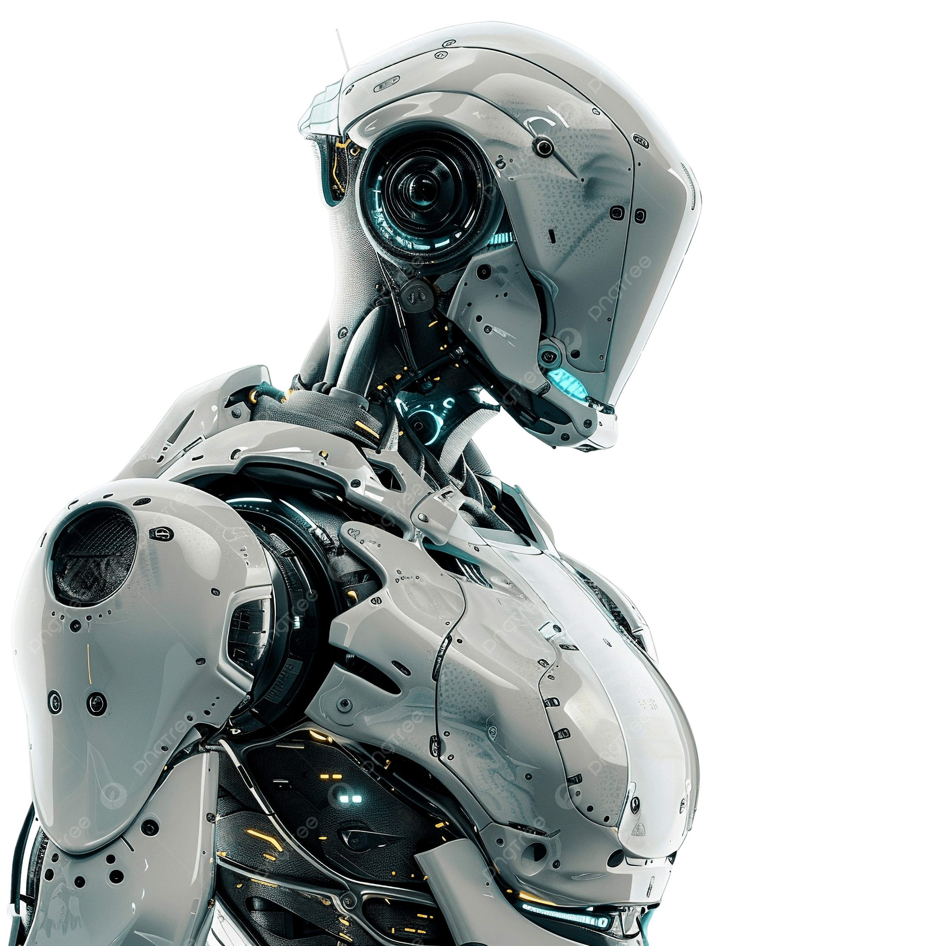
Emerging Technology in 2026
- The year 2026 is poised to witness significant advancements in artificial intelligence and robotics, transforming industries and everyday life.

Slide 2
AI Integration in Daily Life
- Smart homes will become increasingly automated, with AI systems managing everything from energy consumption to security, enhancing convenience and efficiency.
[Visual/Image]

Slide 3
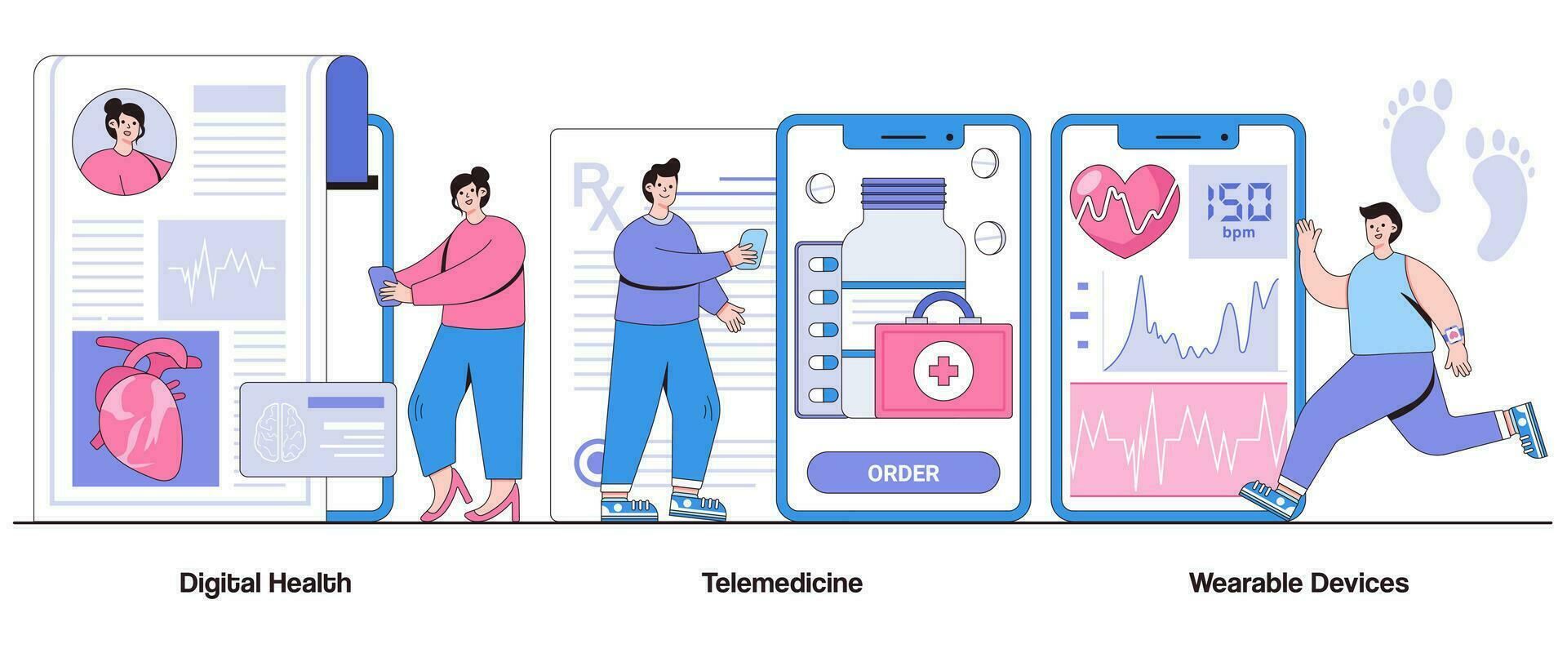
Healthcare Innovations
- Telemedicine will expand, with wearable technology providing real-time health monitoring, enabling proactive healthcare management and personalized treatment plans.

